Slide 1




Media analysis suggests that the cost of living will be a decisive factor in the upcoming midterm elections.
It is for Trump to loose rather than the Democrats to win
Media Tenor analysis | January 2025–October 2026*
Unsplash: Rubaitul Azad, Yang Xia; until October 23, 2026
Basis: 167,761 /105,389 reports on protagonists in the Wall Street Journal, FOX News, WSJ; *October‘s data up to 10/2025

Slide 2
U.S. citizens united in their most pressing concern
Depending on the source, about 50 per cent and more of the U.S. citizens consider the cost of living the most important factor in their Midterm-voting decision. And this is one of the few issues on the public agenda where Republican and Democratic voters are united. So here it seems to matter most what people see in the media and feel in their purses.
The tone of coverage on U.S. president Donald Trump has declined from -7.6 in 2025 to -10 in the first ten months of 2026. At the same time, the tone of coverage on the White House Administration has dropped from plus 7 to -11 points despite a number of efforts to address the problem.
Source: Ipsos/Reuters poll Aug 28-31, 2026
Media Tenor:
Trump: 78 / 79 reports;
White House Administration: 57 / 52 reports

Slide 3
Priorities of voters and media attention
Two different measures: voter importance of the topic and share of coded coverage of the topic 1-10/2026
Issue (polls) / media category
Voters
Media share
Economy / economy and prices
84%
7.5%
Healthcare / health
68%
1.7%
Education / education
62%
0.8%
Immigration / illegal migration
59%
0.5%
The topic labels are approximate: illegal migration is narrower than immigration. Poll percentages are not shares of attention and can total more than 100%.
Pew Research Center: registered voters, Sep 28–Oct 4, 2026; Media Tenor: 105,339 coded statements, CBS, FOX and WSJ, Jan–Oct 2026 (October incomplete).

Slide 4
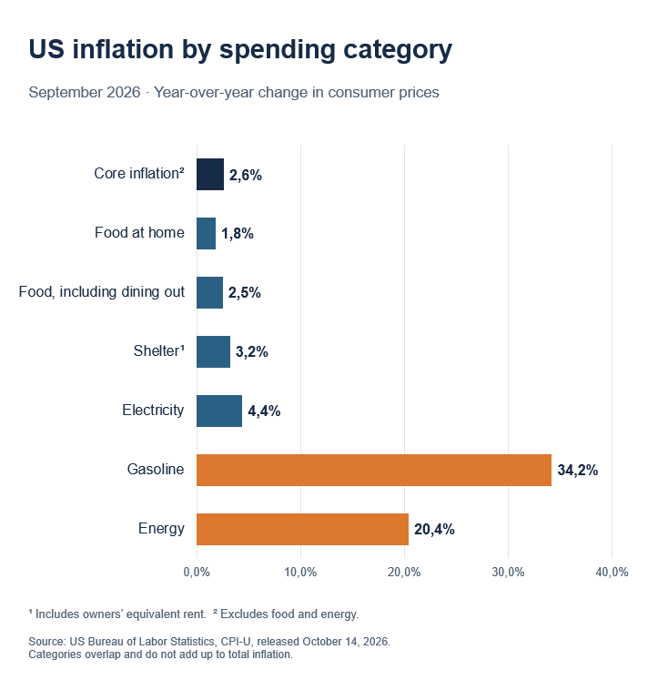
TV news highlight inflation painting a bleak picture of the economy
Tone of coverage on the state of the economy 1/2015 – 10/2026
News coverage of the state of the economy can affect people’s perceptions (e.g. consumer sentiment, investment decisions and fertility rates). The tone of economic coverage on CBS and FOX evening news declined in 2026. Most recently, the issue of the cost of living has contributed most to this decline (e.g. fuel prices). Media emphasis contributes to perceived inflation (along with the frequency of purchasing the particular goods).
Source: Media Tenor, supplied dataset. Coded statements, Jan–Oct 2026; October incomplete. /

Slide 5
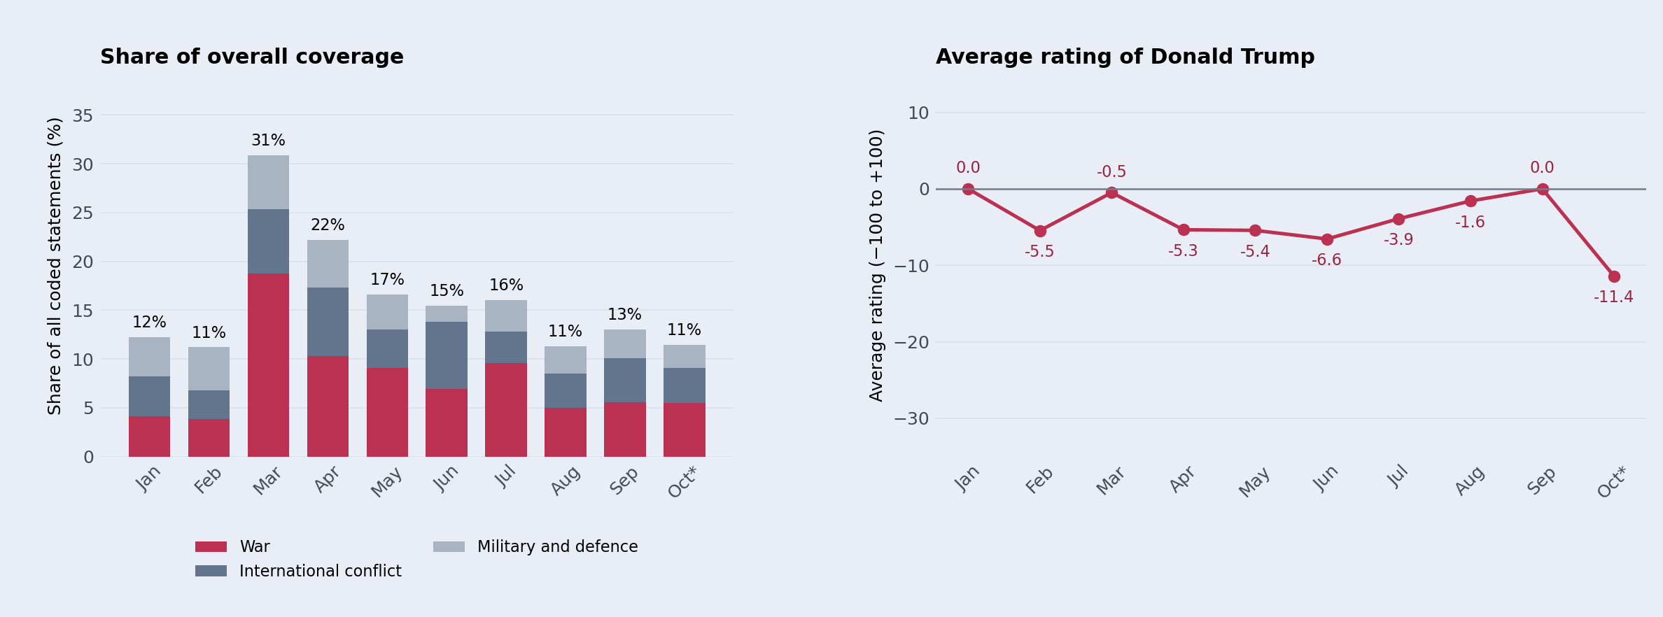
Scepticism over Trump's approach to warfare is on the rise
Monthly share of all coverage and tone of Trump on the same topics 1-10/2026
Left: combined share. Right: (positive − negative) / all Trump statements × 100; neutral included.
Source: Media Tenor. CBS, FOX, WSJ; 3,693 coded reports on Donald Trump, Jan–Oct 2026. Topic groups: Warfare, International conflicts, Military, defence. October incomplete.

Slide 6
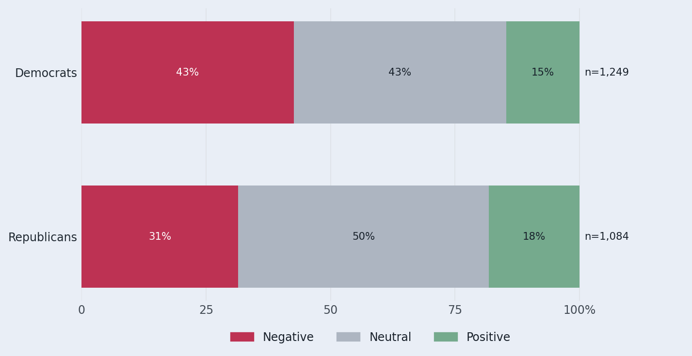
If Democrats score a home run, it is not because the Media like them
Tone of coverage of party organisations and congressional groups 1-10/2026
The overall tone of the coverage of the Democrats, Republicans and related congressional groups has been negative, but more so for the Democrats than the Republicans. Therefore, despite declining approval rates for U.S. President Donald Trump, the midterm elections are not a home run for the Democrats.
But Agenda Setting and Elections teach anyhow only one lesson:
The incumbent has to loose it.
Source: Media Tenor, supplied dataset. Coded statements, Jan–Oct 2026; October incomplete.

Slide 7
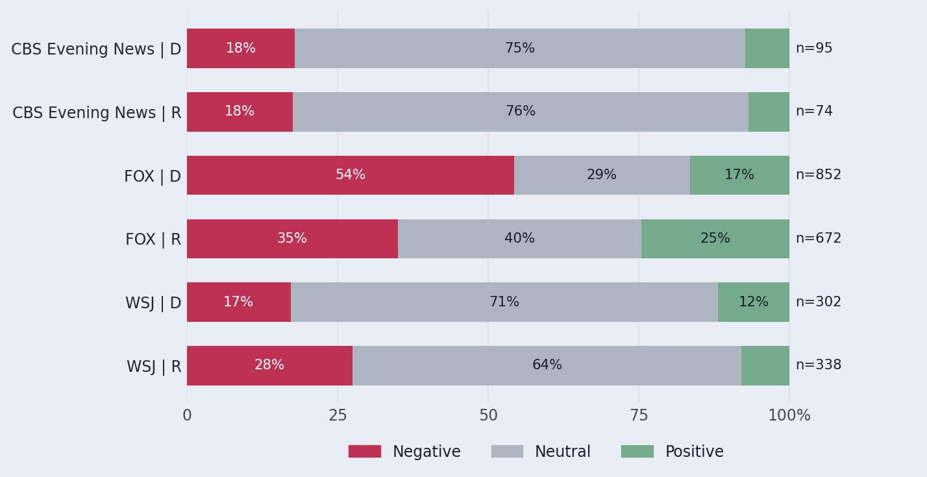
FOX News and the WSJ feature notable criticism of Republicans
Tone of party and congressional-group statements
Taking a closer look at FOX News reveals some interesting insights into both parties and their organizations. The Democrats have been criticized most for their parliamentary work, allegations of socialism and an alleged lack of internal unity.
The Republicans, on the other hand, have been criticized for their stance on international unity, opinion poll results and parliamentary work. It can be assumed that the purpose of this topic selection is to encourage unity and align with the presidential agenda.
Source: Media Tenor, supplied dataset. Coded statements, Jan–Oct 2026; October incomplete.

Slide 8
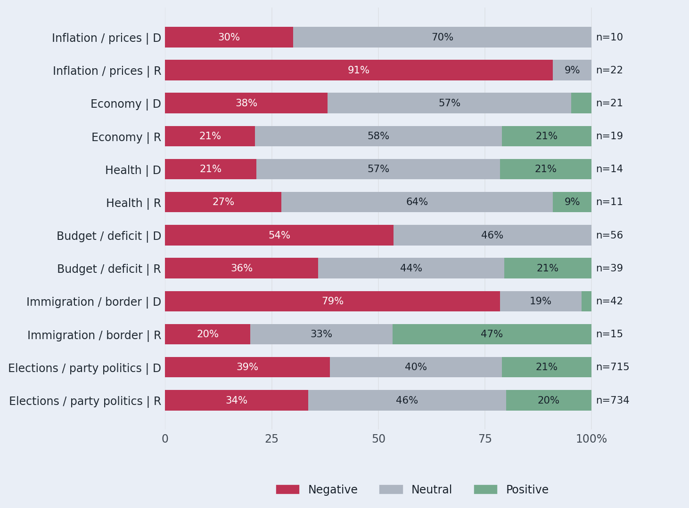
Moderate visibility on pressing issues
Within-issue tone distribution; D = Democrats, R = Republicans
So far in 2026, both parties and their organizations have had moderate visibility on pressing issues. The vast majority of statements addressed elections, opinion polls and party politics.
Taking into account the caution required when interpreting moderate levels of statements, the Republicans achieved a more favorable rating on the economy, budget deficit and immigration/border issues. The Democrats scored higher on health and inflation issues.
Source: Media Tenor, supplied dataset. Coded statements, Jan–Oct 2026; October incomplete.

Slide 9
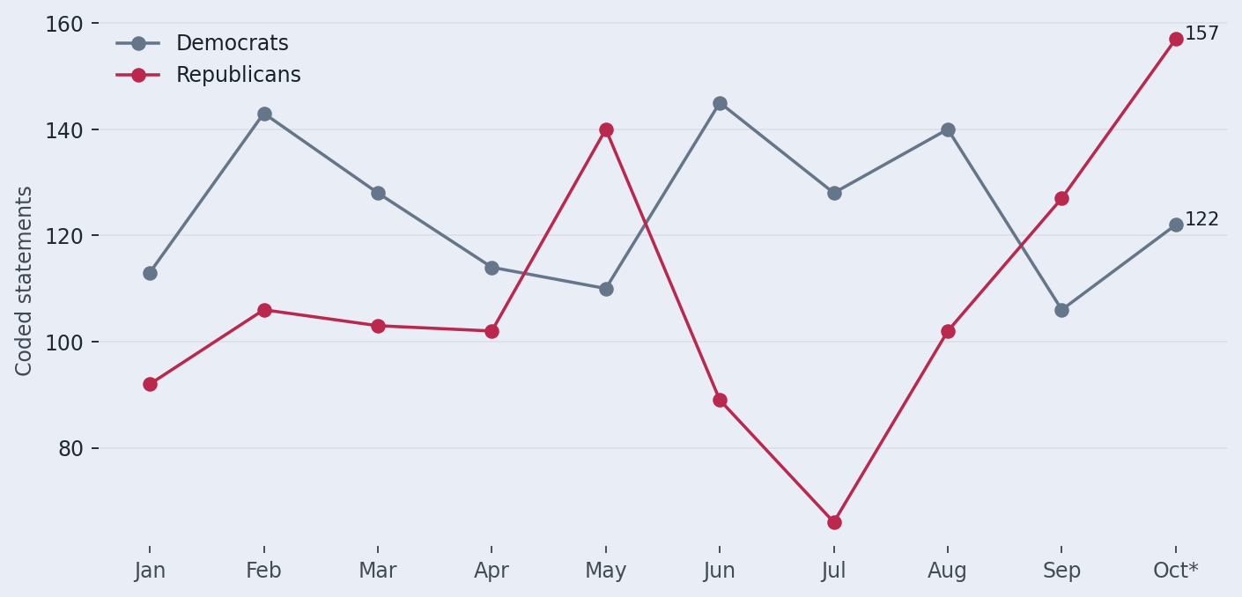
Republicans gain visibility ahead of the midterms
Coded statements per month
So far in 2026, both parties and their organizations have experienced varying degrees of visibility. Overall, the news has focused much more on the president and the White House administration.
Source: Media Tenor, supplied dataset. Coded statements, Jan–Oct 2026; October incomplete.

Slide 10
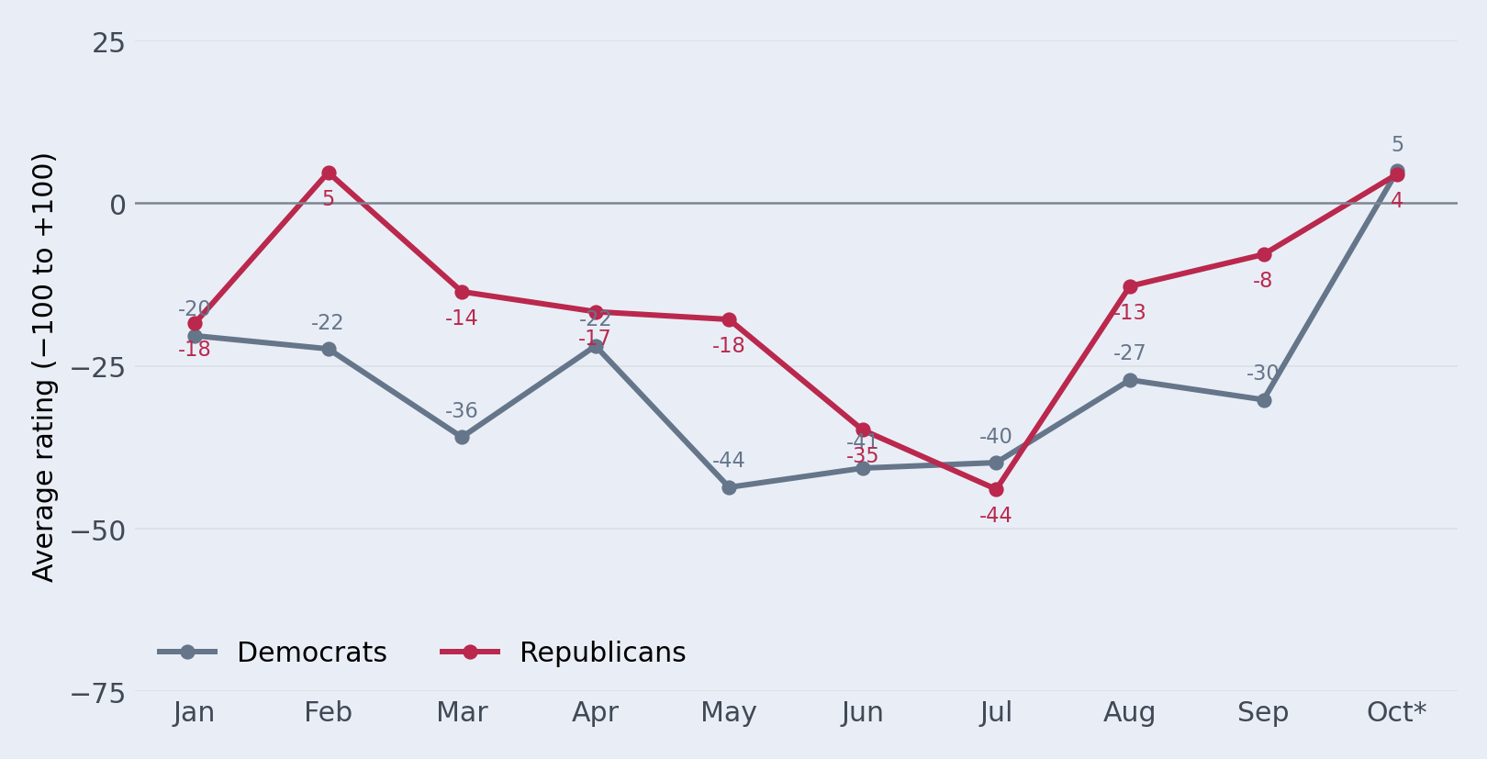
Horse race coverage adds positivity to Democrats’ image
Average tone of party organisations and congressional groups
Election forecasts and approval rates have been the main driver behind the favorable trend in news reporting on the Democratic Party and its organizations.
Source: Media Tenor, supplied dataset; CBS, FOX, WSJ. January–October 2026; October incomplete.

Slide 11
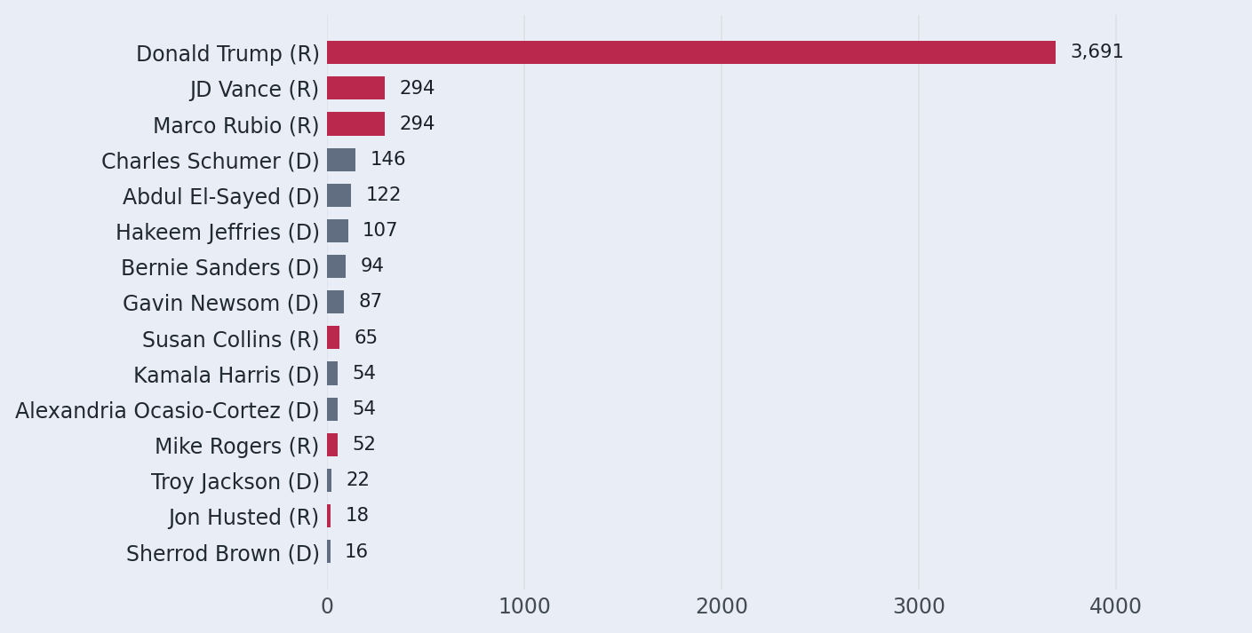
Candidates have visibility issues
Salience: volume of coded statements
Looking at the news coverage on some of the candidates and comparing it with Donald Trump and members of his administration, we see that the “news machine” Donald Trump has dominated the entire political arena, making it rather difficult for candidates to achieve a distinguished profile on their respective issues.
Source: Media Tenor, supplied dataset. Coded statements, Jan–Oct 2026; October incomplete.

Slide 12
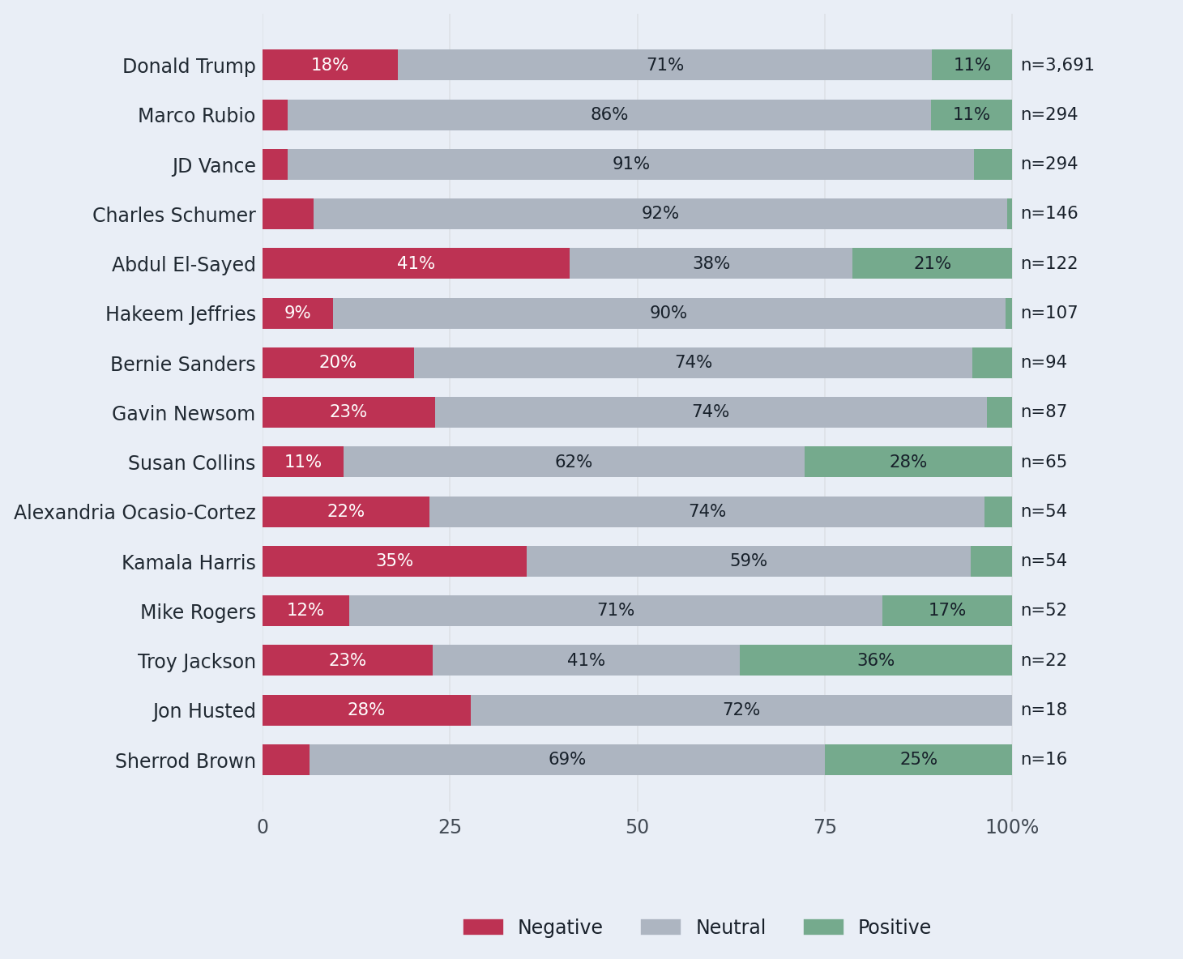
How political figures are portrayed
Tone by protagonist; ranked by coverage volume
Source: Media Tenor, supplied dataset. Coded statements, Jan–Oct 2026; October incomplete.

Slide 13
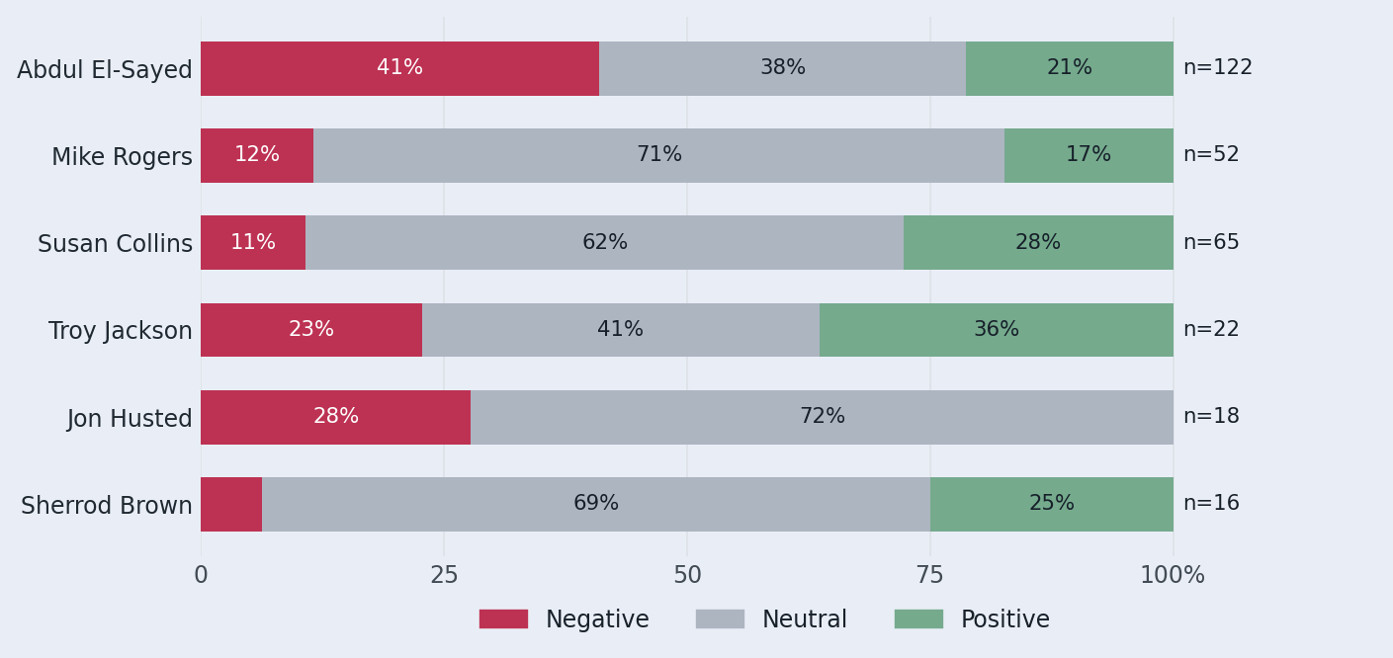
Senate candidates: visibility and tone
Selected Senate candidates in Maine, Michigan and Ohio
Source: Media Tenor, supplied dataset. Coded statements, Jan–Oct 2026; October incomplete.

Slide 14
Scope and interpretation
Definitions and limitations
Unit: a coded statement about a protagonist, topic and outlet. Rows are aggregates of statement counts.
Party comparison: party organizations and congressional party groups only. Individuals and administrations are separate.
Positive, neutral and negative shares use all statements in the respective group.
October‘s data up to 10/2025.
Analyzed media: CBS evening news, FOX evening news, WSJ (sample coded)
Source: Media Tenor, supplied dataset. Coded statements, Jan–Oct 2026; October incomplete.

Slide 15

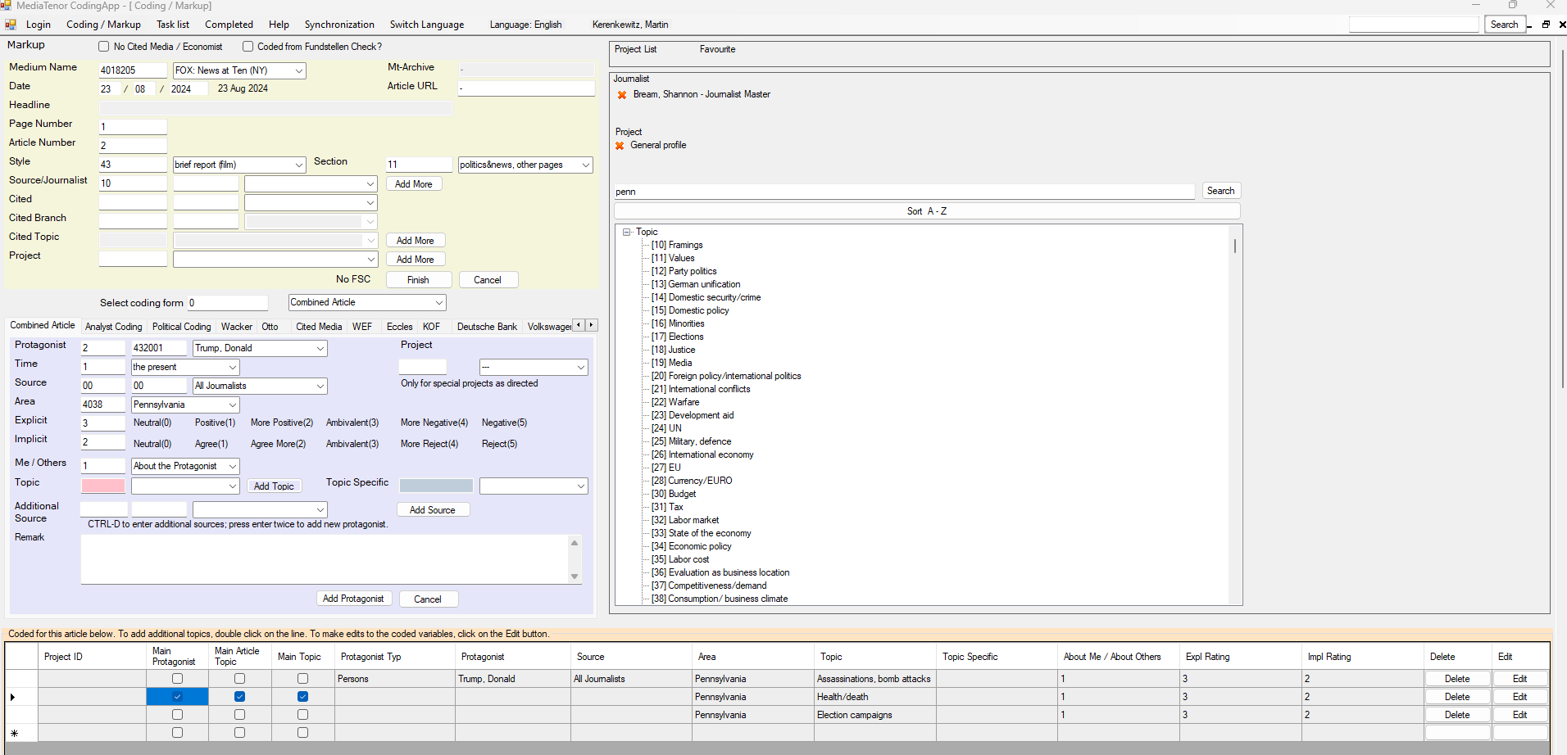
Method
Scientific content analysis carried out by trained staff – inter-coder reliability: 87% Q4 25

Slide 16
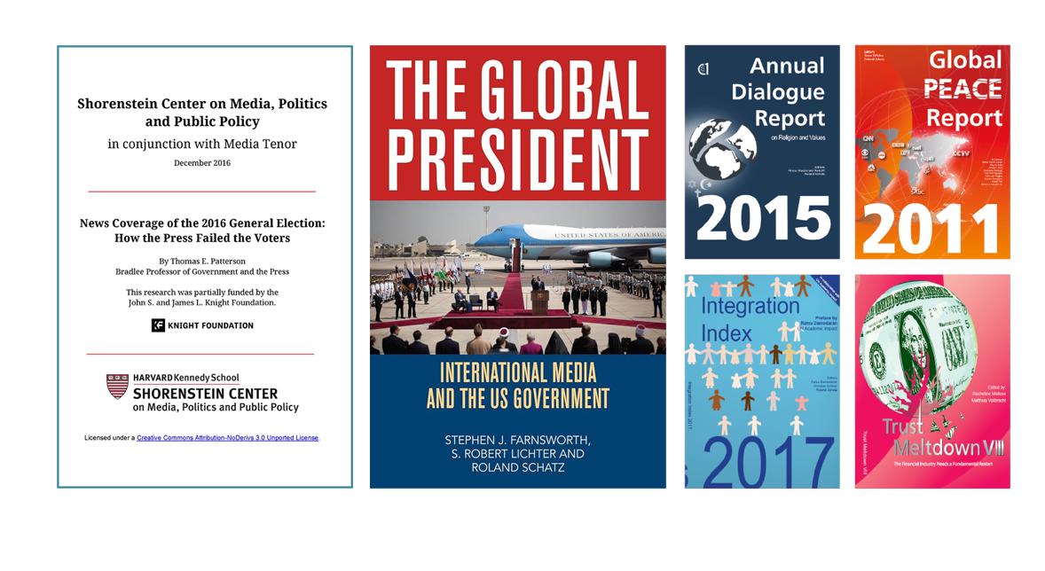
Background
Roland Schatz is a fifth-generation journalist. As founder and CEO of Media Tenor International, he served as Senior Advisor to UN Director-General Michael Moller from 2013 to 2019, and in the same capacity to Mafalda Duarte, Head of the World Bank’s Climate Investment Fund, from 2019 to 2020. In 2020, Pope Francis appointed him to his Covid Commission to report via weekly newsletters in 10 languages.
Media Tenor International
Roland Schatz
Lüssirainstrasse 96
CH – 6300 Zug
r.schatz@mediatenor.com
Tel.: +49 151 237 19 786
Media Tenor has been publishing analyses of US presidential election campaigns since 2000. These have been published in reports by the Shorenstein Center at the Harvard Kennedy School. Media organisations such as the BBC, CzechTV and SABC have been using Media Tenor’s analyses for decades. The studies are available free of charge at www.mediatenor.com.

